Slide 1

Promoting my new beer in Belgium
Coursera Capstone Project

Slide 2

Who want’s to taste my beer?
Reach new customers
Brand recognition
Break through the noise
Sales ++++

Slide 3
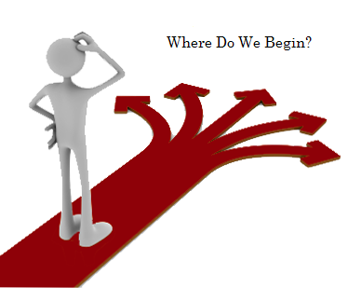
Find the best place to start
Use Data
Input : Locations and relevant venues to beer consuming
Output : Best location to promote your beer

Slide 4

How?
Foursquare venue data
Recommand area’s based on beer related venues : pubs, bars, restaurants…

Slide 5
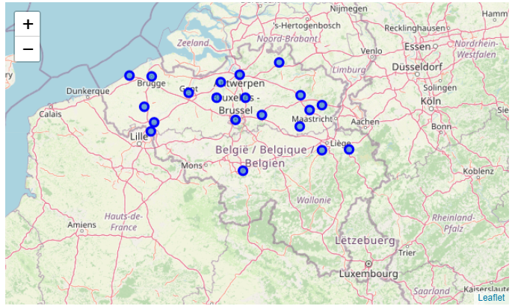
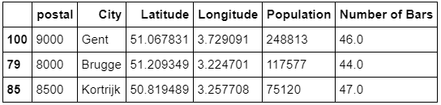
Example : New Beer In Belgium
Big City’s
A lot of Bars
Venues related to beer of the Top 100 venues / City

Slide 6
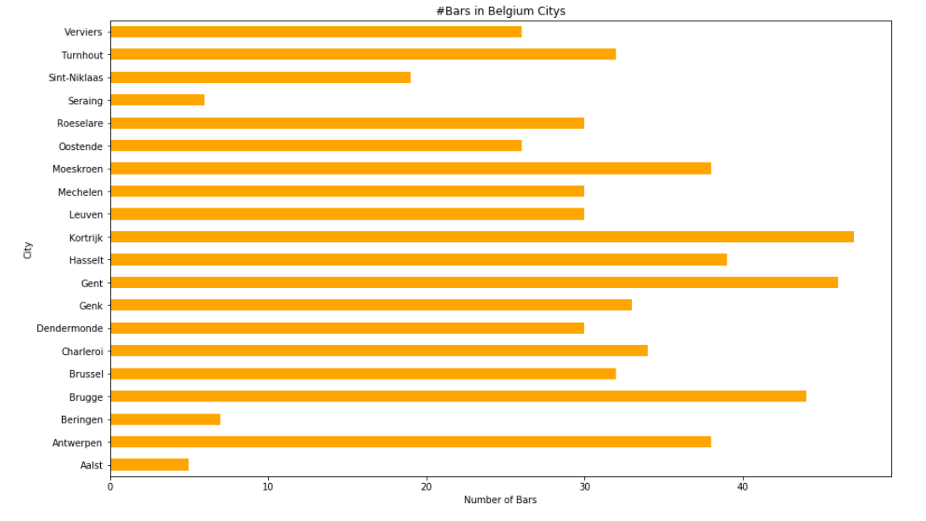

Slide 7
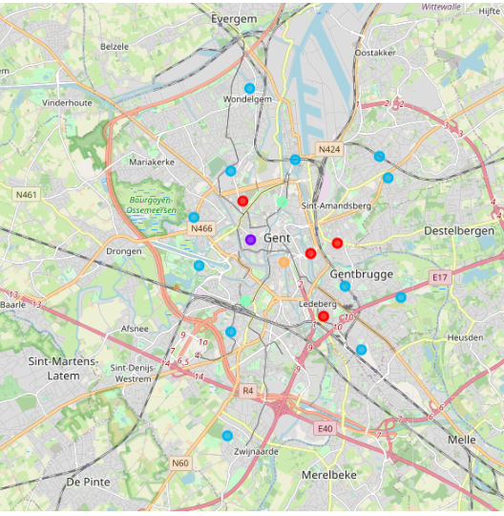
Repeat proces local
Retreave Most important Venue data related to beer for every Neighbourhood
Cluster Neighbourhood on ‘beer’ relevant venue’s
Orange most relevant neighbourhood

Slide 8
Conclusion
Finding the best city with relevant venues
Clustering the neighbourhoods to find the perfect promoting campaign location. This is where you want your posters, free giveaways , folder and logos to be.
Can be used by any brand related to restaurants and bars

Slide 9
Future additions
Include data about wealth and age to locate target audience even better
Allow users to change the relevant venues for their product and promoting campaign

